Slide 1
Special probability distributions

Slide 2
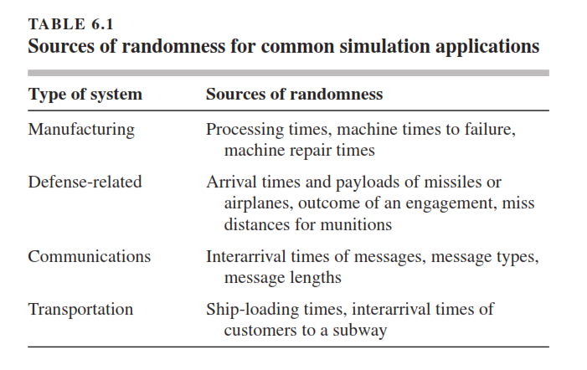

Slide 3
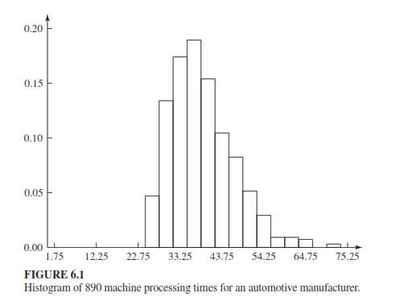

Slide 4
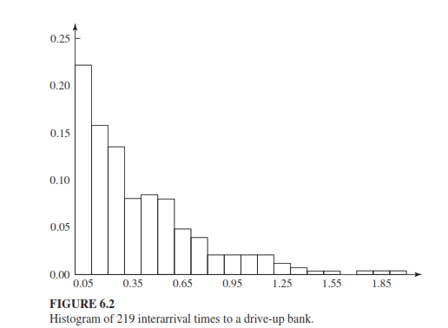

Slide 5
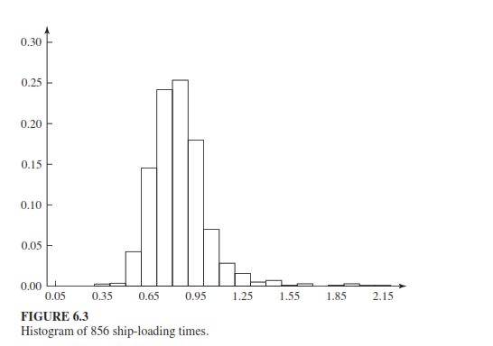

Slide 6
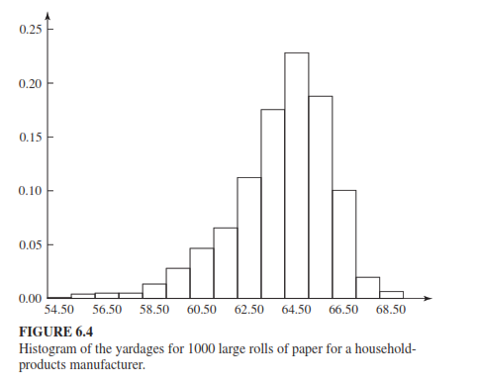

Slide 7
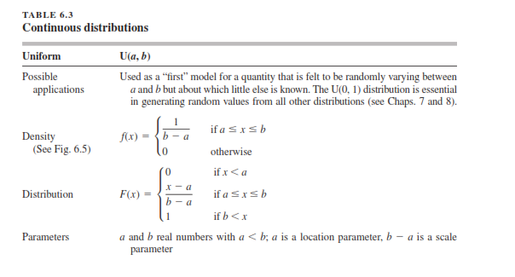

Slide 8
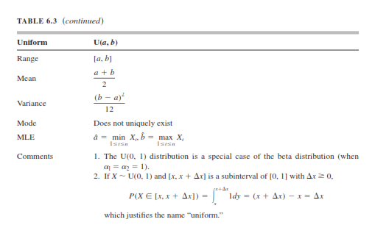

Slide 9
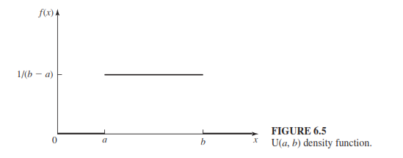

Slide 10
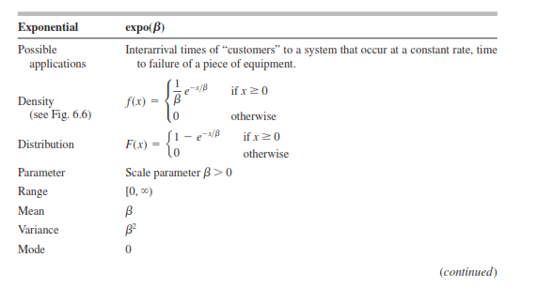

Slide 11
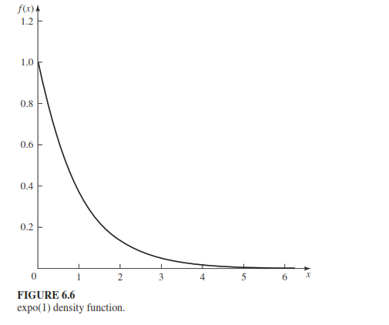

Slide 12
Central Limit Theorm
The central limit theorem states that if you have a population with mean μ and standard deviation σ and take sufficiently large random samples from the population with replacement , then the distribution of the sample means will be approximately normally distributed

Slide 13
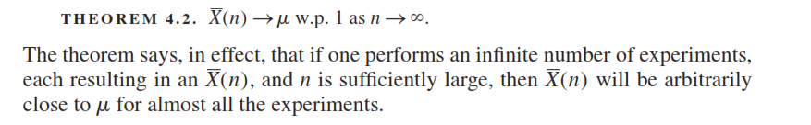
The Strong Law of Large Numbers
Let X1, X2, . . . , Xn be IID(Independent and identically distributed) random variables with finite mean(µ) . Then the strong law of large numbers is as follows.

Slide 14
